Slide 1
PVGPT Query the PV data using natural language
Research assistant: Di Zhang
Supervisor: Prof. Zhe Wang
​
Department of Civil and Environmental Engineering
The Hong Kong University of Science and Technology
6 Nov 2025

Slide 2
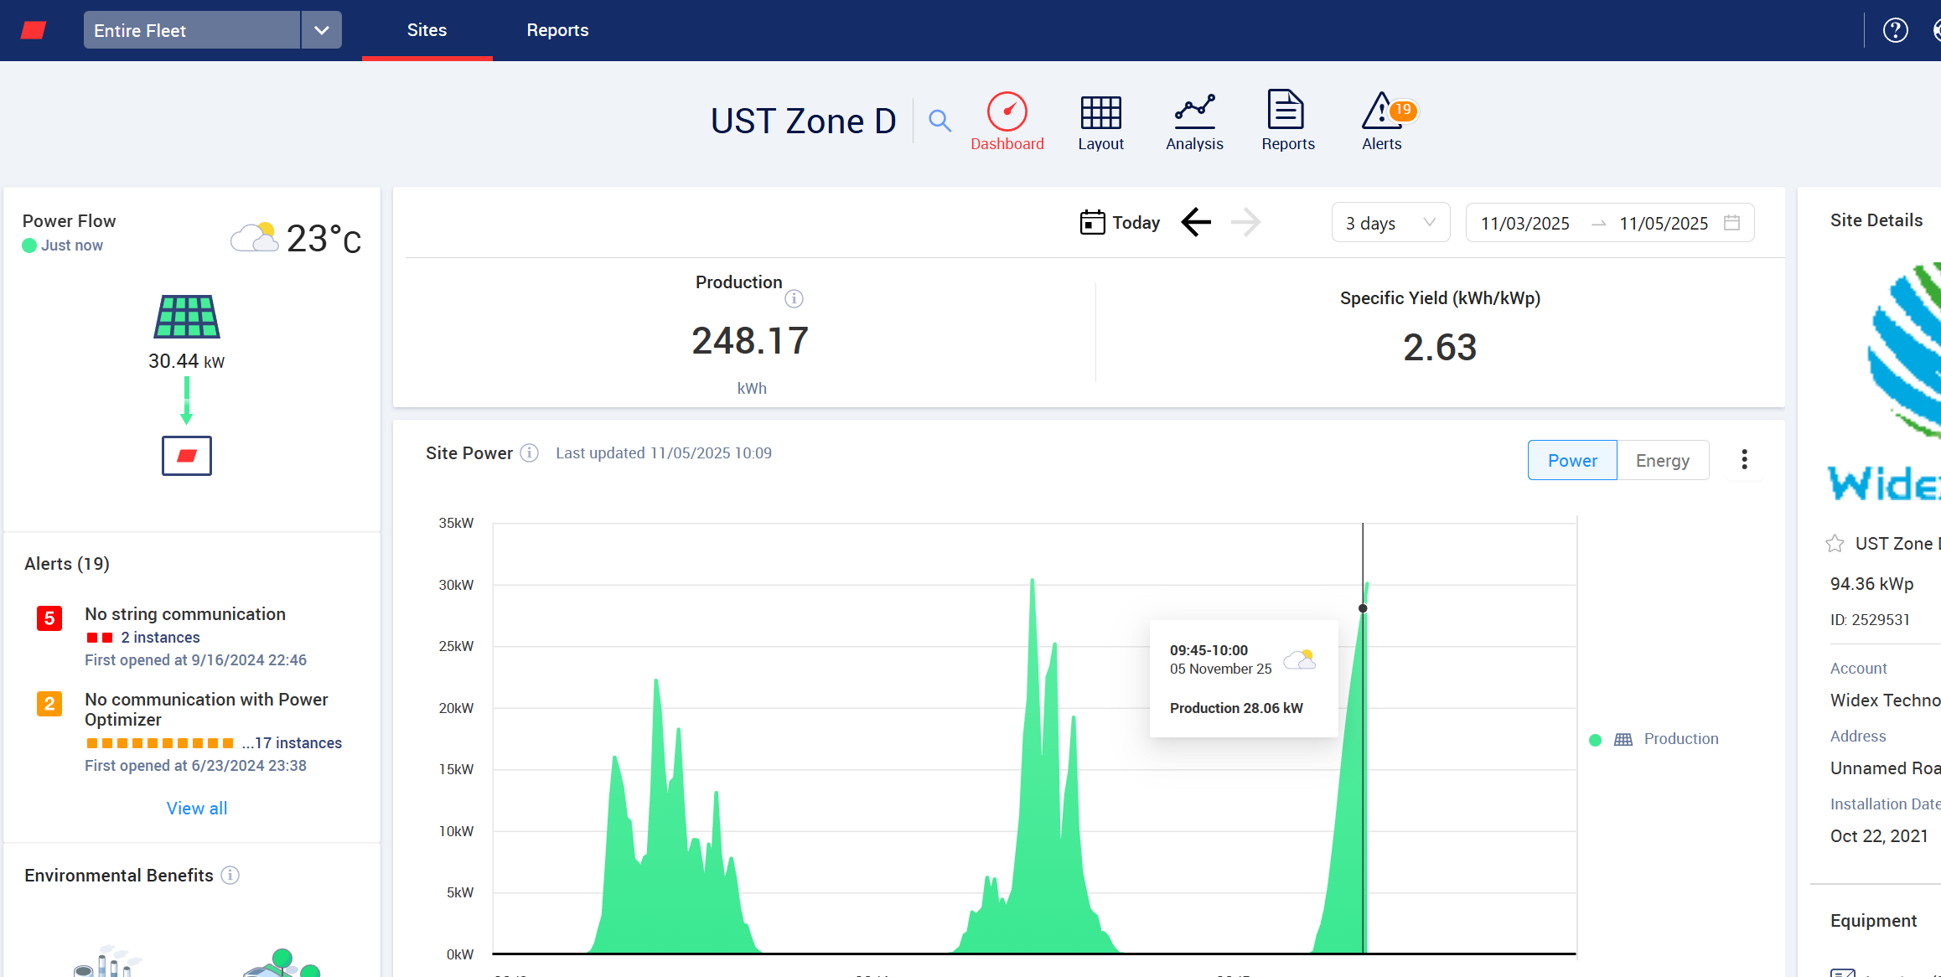
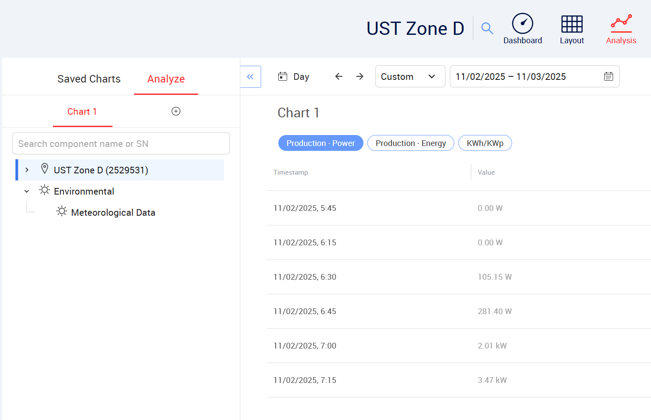
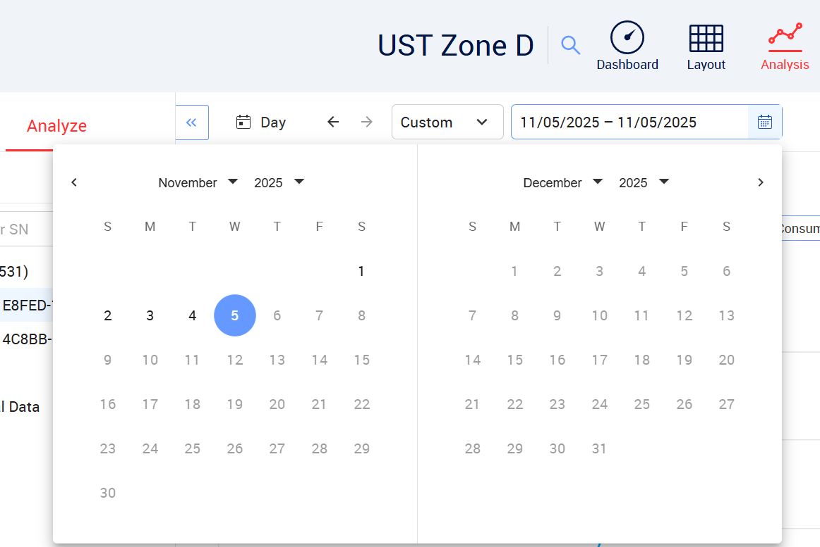
A LLM-based system provides natural-language querying and analysis
PVGPT: Query the PV data using natural language
39 sites at HKUST, 2486 panels, since Jan 2021
1
? have challenges:
How can heterogeneous PV data from different sensors and APIs be unified into one interoperable framework?
How can non-technical users flexibly query and analyze such data without knowing complex scripts?
3
2
PV data is complex and heterogeneous！

Slide 3
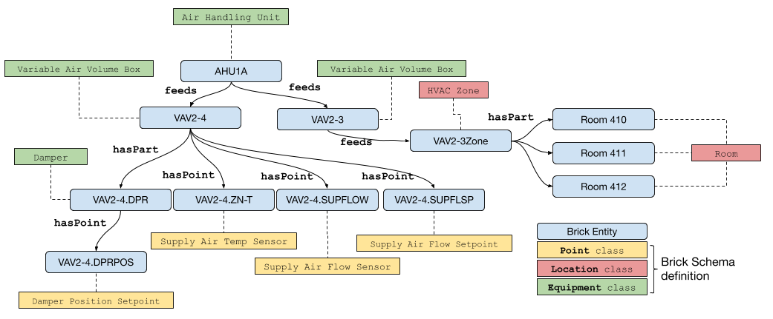
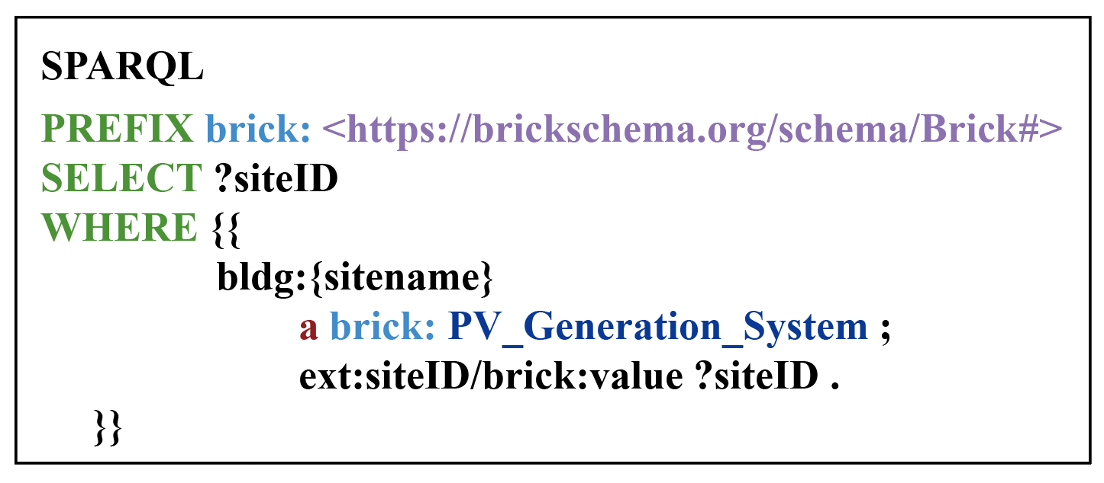
Ontologies like Brick can standardize and integrate heterogeneous data
Semantic model:
Record relationships among sites, sensors, and data streams in a standardized, machine-readable way.
Semantic models are difficult to query!

Slide 4
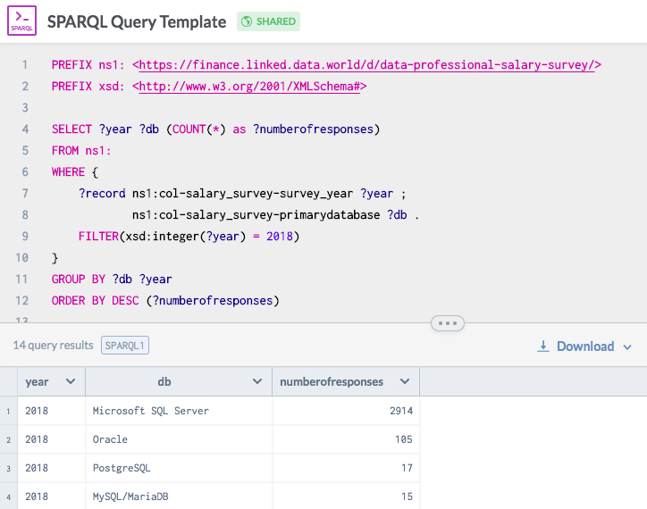
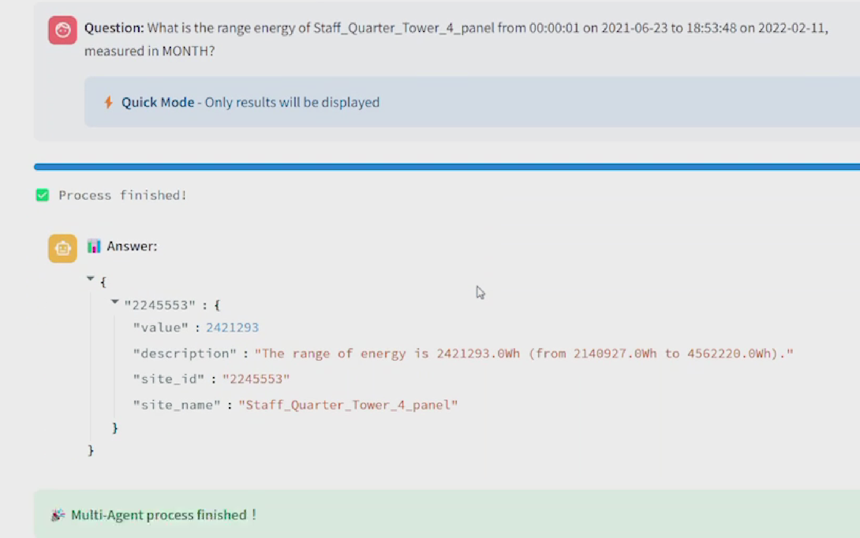
Semantic integration is powerful, but not accessible
? LLM can help:
Generate code according to natural language throughout the semantic model to query PV data using natural language
Existing Methods
LLM Methods
Goal: Make accessing pv data as simple as talking to a person.

Slide 5
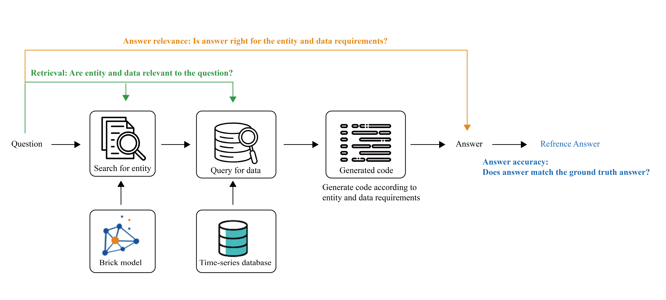
How can LLMs handle multi-step PV queries?
From entity retrieval to code generation:
Require LLMs to reason through semantic relationships, manage heterogeneous data, and ensure execution correctness.
Challenges: How can LLM handle multi-step PV queries with correcting itself at each stage?

Slide 6
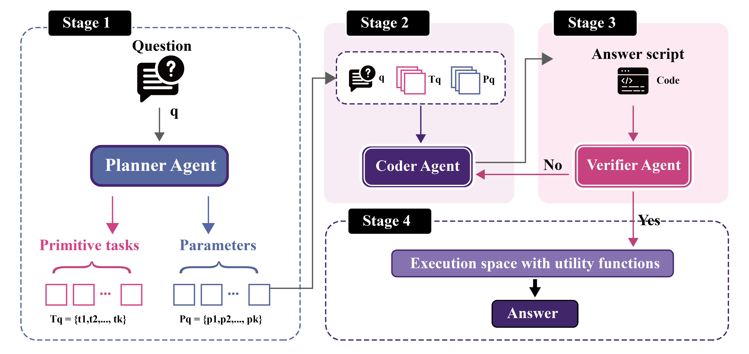
Multi-agent architecture for reliable PV data querying
Planner–Coder–Verifier:
Each agent specializes in one stage of the reasoning chain — Planner decomposes tasks, Coder generates executable code, and Verifier executes and corrects errors, ensuring robustness across heterogeneous PV APIs.

Slide 7
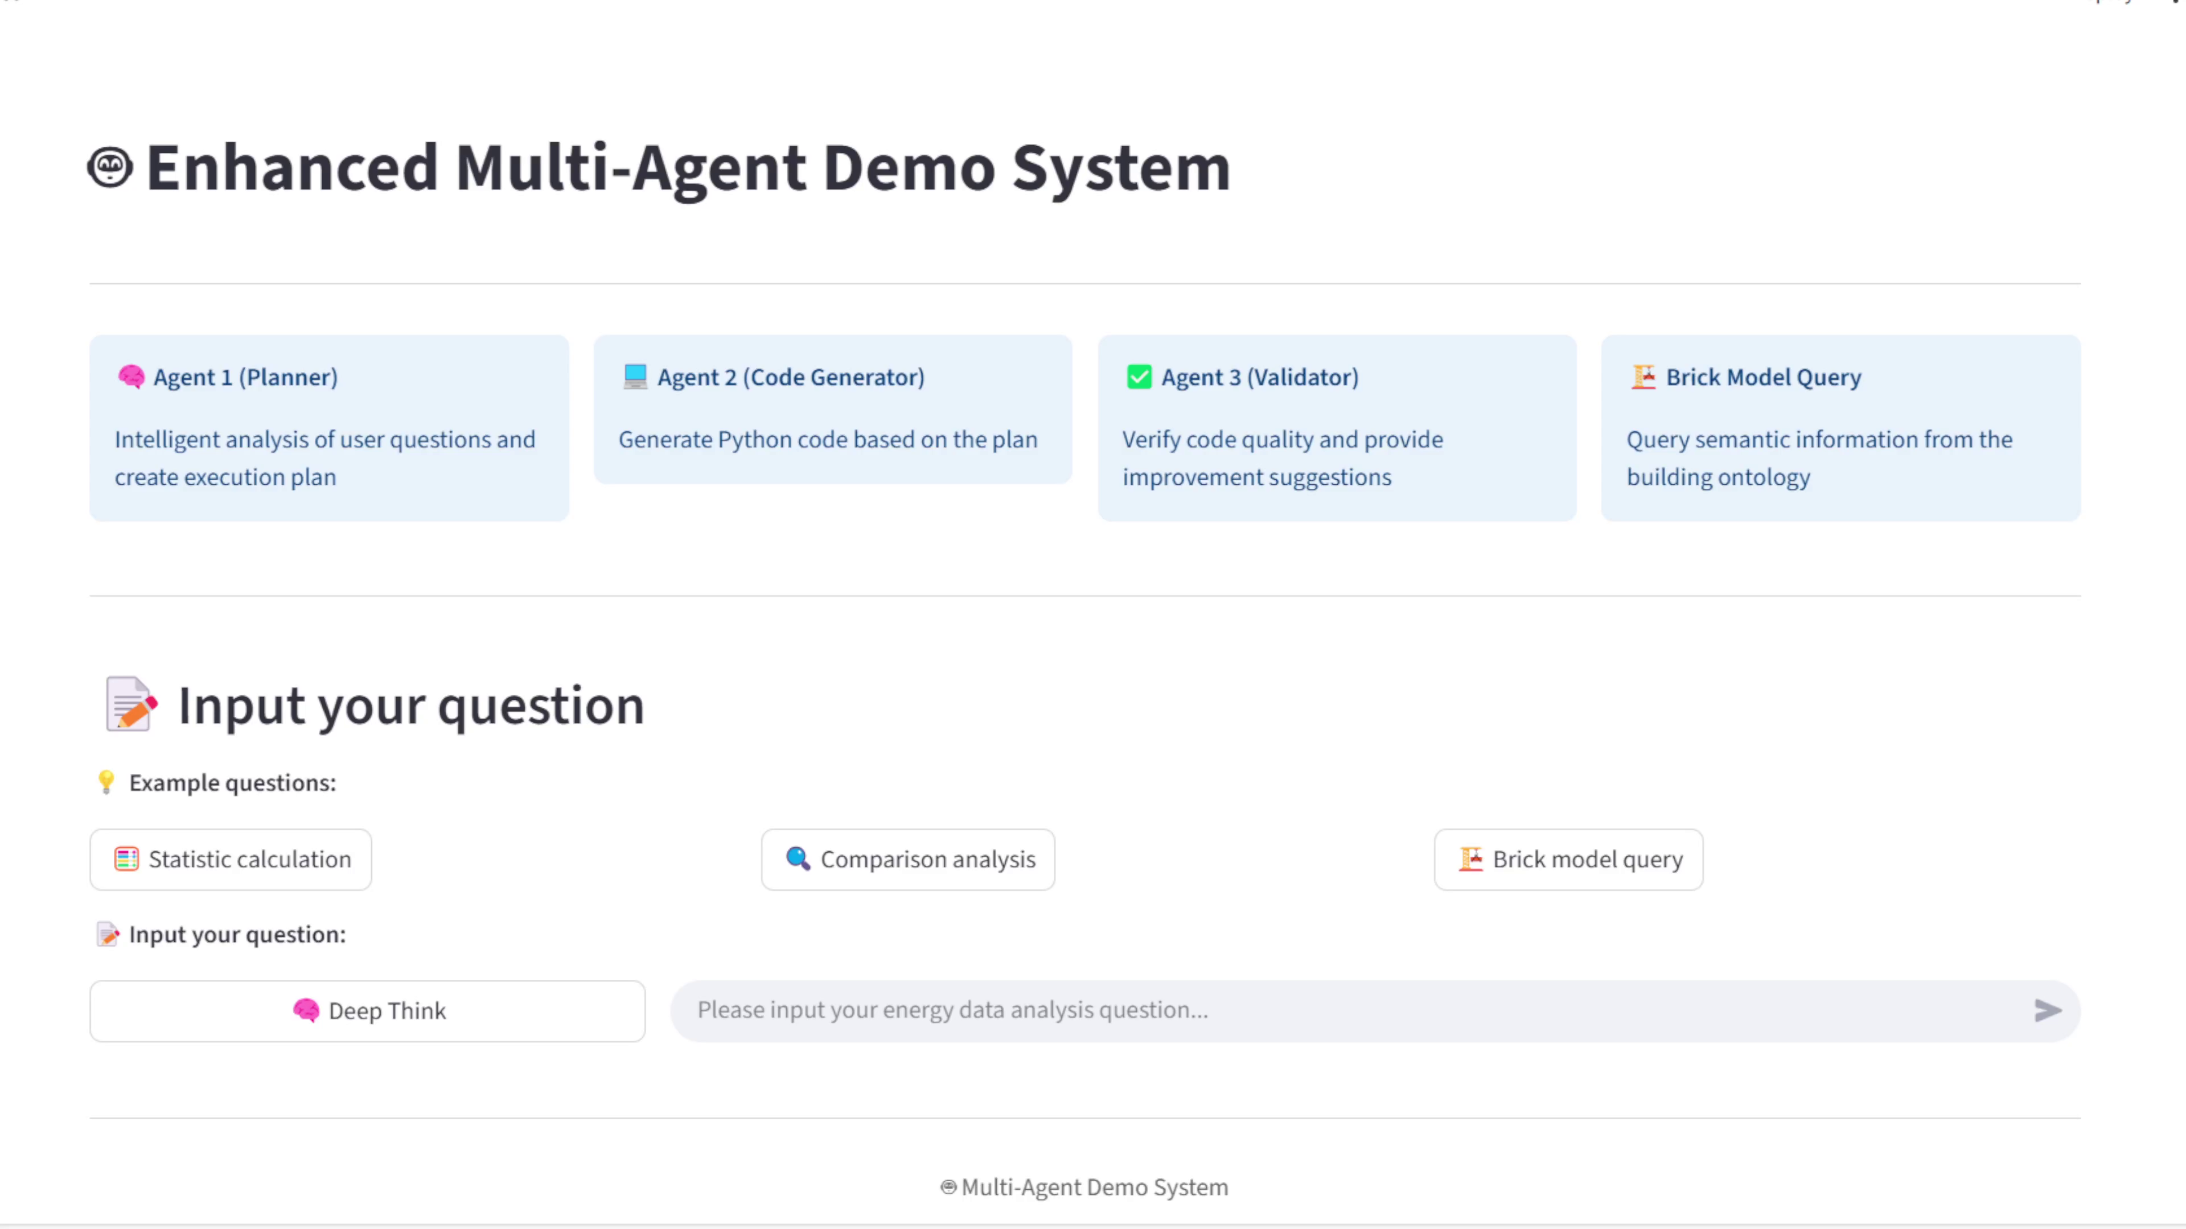
Demo

Slide 8
Make PV data easily accessible for everyone !
THANK YOU!
Research assistant: Di Zhang
Supervisor: Prof. Zhe Wang
​
Department of Civil and Environmental Engineering
The Hong Kong University of Science and Technology
6 Nov 2025

